Slide 1


Kasie West
By: Kendralyn Burr
Notes:
Image: https://www.teenreads.com/authors/kasie-west

Slide 2

Biography
Born October 23, 1976 in California
Received bachelor’s degree in Elementary Education
Married to Jared
Has four kids (3 girls, 1 boy)
Currently lives in central California
Published 1st book in 2013 (Pivot Point)
Fell in love with writing while being a stay at home mom
Favorite authors are Jane Austen and Charles Dickens
Notes:
Image: https://www.goodreads.com/author/list/5027236.Kasie_West
Information: West, K. (2019). FAQ. Retrieved from http://www.kasiewest.com/p/faq.html

Slide 3
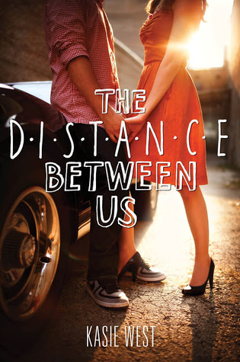
The Distance Between Us
The Distance Between Us is the first stand-alone romance novel written by Kasie West. This is a humorous tale of a hardworking, sarcastic girl named Caymen that despise rich people. She works in her mom’s porcelain doll shop where she meets Xander, a wealthy son of a hotel mogul, whom she can’t get out her head. She learns that maybe wealthy people aren’t so bad after all.
Notes:
Image: https://www.goodreads.com/author/list/5027236.Kasie_West

Slide 4

The Fill-In Boyfriend
Another popular romance novel she wrote is called The Fill-In Boyfriend. Gia’s boyfriend, Bradley, dumps her in the school’s parking lot on prom night. In need of a date to impress her friends, she asks a random stranger to pretend to be Bradley. However, she begins to develop feelings for her fake boyfriend. Her lies catch up to her and threaten her friendships and new-found relationships.
Notes:
Image: https://www.goodreads.com/author/list/5027236.Kasie_West

Slide 5

Fame, Fate, and the First Kiss
Kasie’s most recent romance novel, Fame, Fate, and the First Kiss was published in February 2019. Lacey is an actress and has received a role that could be her big break. She has trouble bonding with her costars and completing homework assignments. Her dad hires a straight-laced tutor, Donovan, whom she develops a crush on. Donovan turns out to not be a distraction and helps her find the set’s saboteur who is threatening her career.
Notes:
Image: https://www.goodreads.com/author/list/5027236.Kasie_West

Slide 6

Book Review: By Your Side
Professional Review: Kirkus Magazine
After a weekend trapped in a library together, two teens from different social stratospheres are drawn to one another.
All Autumn, a white senior, wanted to do was go to the bathroom. She had been studying with her friends in the library before it closed, excited to go build a campfire in the canyon. Instead, she finds herself locked in the library, her friends gone and her phone with them. But she’s not alone: Dax, a white loner with a bad reputation, has purposely stayed behind, unaware of her presence. It’s a three-day weekend, and the two while the hours away with games and standoffs, each wary of trusting the other. As Autumn warms to Dax, he remains distant, and her friends never show up. When the reason for their absence is revealed and Autumn’s anxiety disorder spirals, it’s Dax who saves the day. Afterward, however, Dax pretends they’re strangers, and Autumn’s friends have expectations for who she should be with, and it sure isn’t Dax. The feeling of calm that Dax brought out in Autumn pulls her to him anyway, and soon she must decide what she really wants. Though quite slow to start, Autumn and Dax’s relationship burns brightly. Autumn’s struggles with anxiety are equally dynamic. If only the rest of her life—her friends and other love interest—were equally engaging.
A simmering romance that gives weight to mental health and hard choices. (Fiction. 13-18)
Notes:
Image: https://www.goodreads.com/author/list/5027236.Kasie_West
Review: Kirkus Review. (2016). Retrieved from https://www.kirkusreviews.com/book-reviews/kasie-west/by-your-side/

Slide 7
Book Review: By Your Side
Young Adult Review: Pikes Peak Library District Website
Rating:
5 stars = Bohemian Rhapsody Awesome!
Review:
If you didn't already guess from the title yes, this is a romance book. It is realistic fiction and isn't part of a series. It is a pretty short read. With heartbreaks, lies, high school drama and some hospital visits this book will be hard to put down. The book is a little predictable but it isn't your typical love story. This is another great book I have read this year.
Reviewer grade: 8th
Notes:
Image: https://www.goodreads.com/author/list/5027236.Kasie_West
Review: E.C. (2016). Book Review: By Your Side. Retrieved from https://ppld.org/book-reviews/your-side

Slide 8




More Books By Kasie West
Notes:
Images: https://www.goodreads.com/author/list/5027236.Kasie_West

